Slide 1

Deep Learning
Pradip Tivhale

Slide 2
Machine Learning
AI
Deep learning

Slide 3
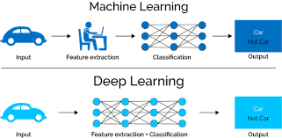
ML Vs DL

Slide 4
Neural Network
Input
Hidden layer
Output layer

Slide 5
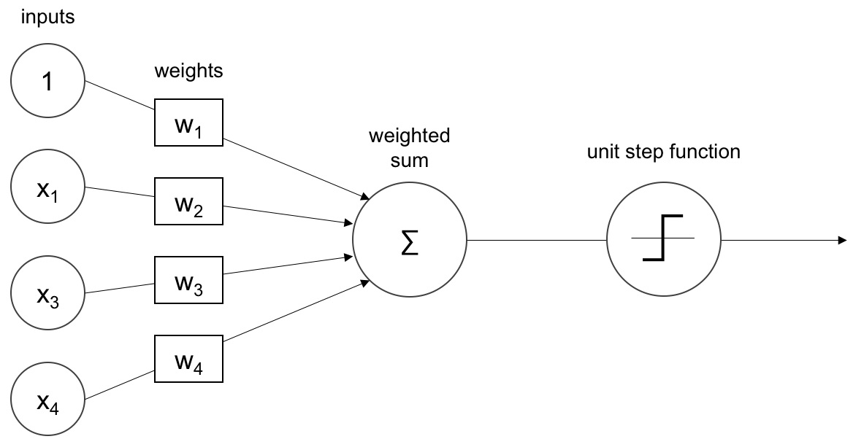
Perceptron

Slide 6
Why Deep Learning now
Data
Computation power(moore's law)
Video

Slide 7
Unit
Line equation
Correlation with Unit

Slide 8
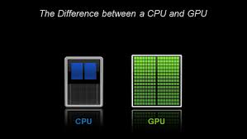
CPU vs GPU

Slide 9
NN Parameter
Layers
Activation function
optimizer

Slide 10
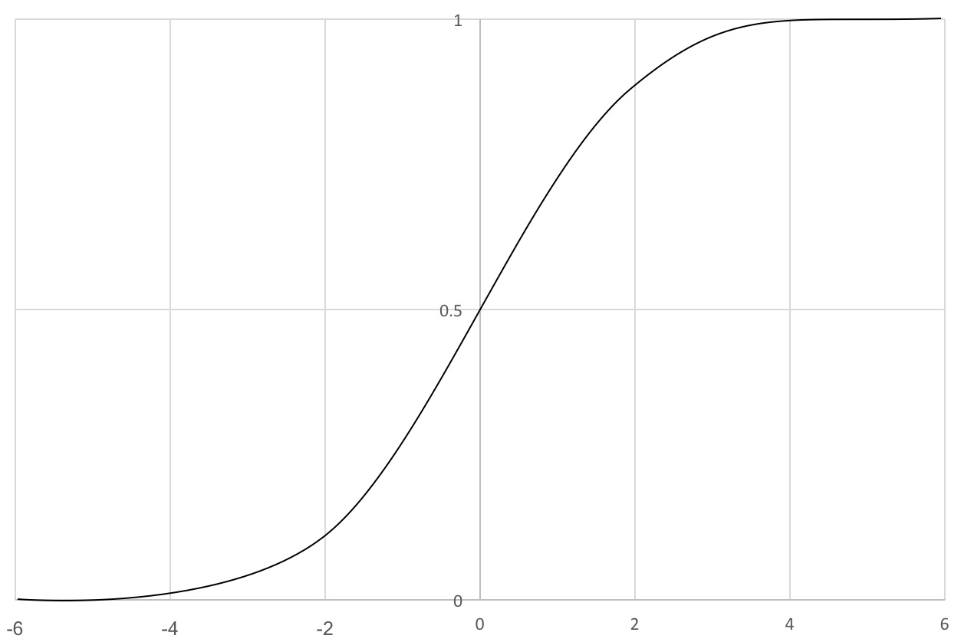
Activation function: Sigmoid

Slide 11
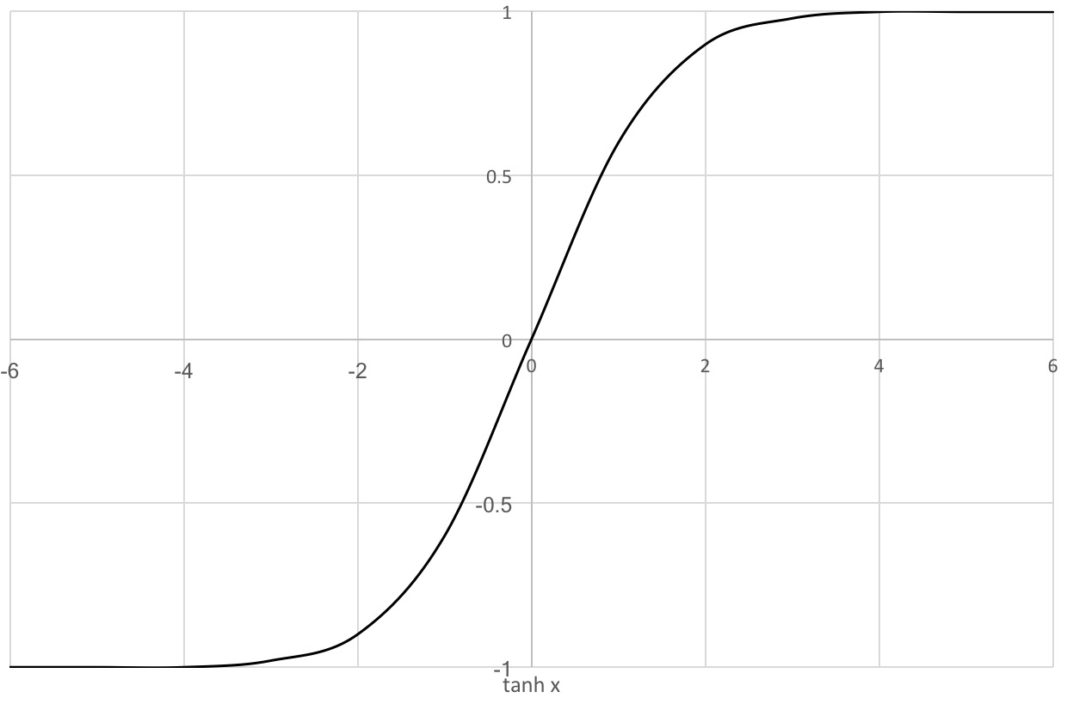
Activation function: tanh

Slide 12
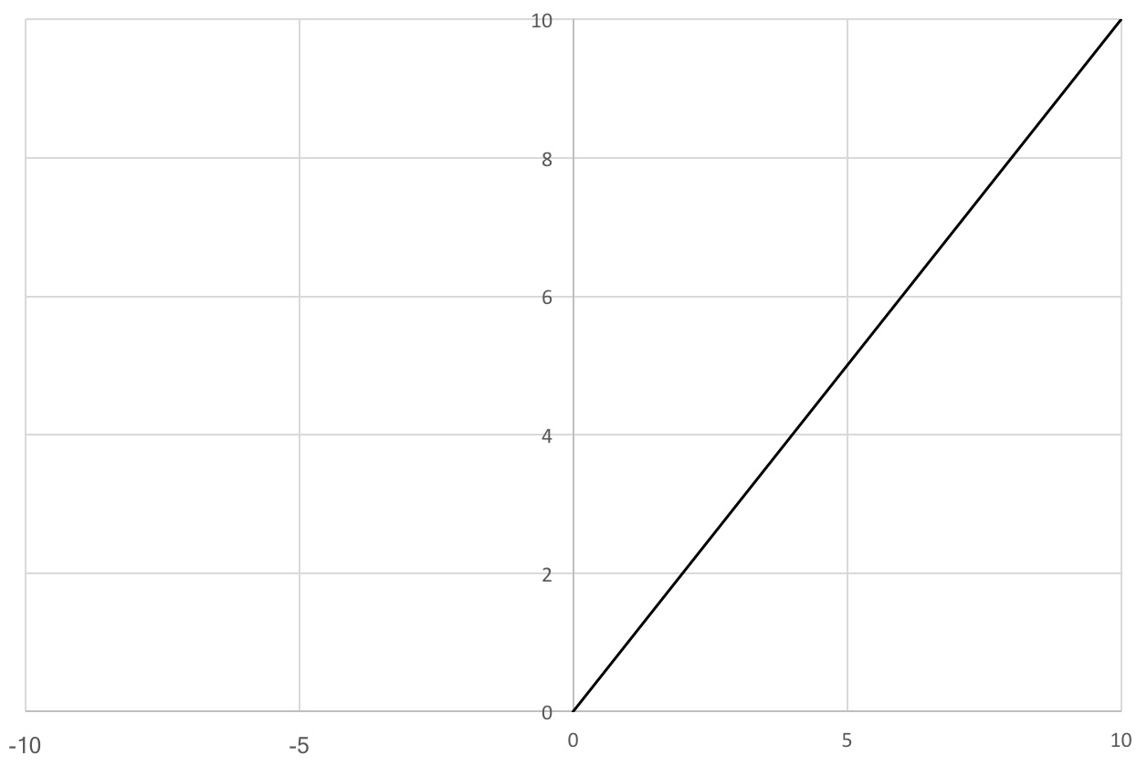
Activation function: The Rectified Linear Unit (ReLU)

Slide 13
Softmax
Softmax is a way of forcing the neural networks to output the sum of 1.
Used in Output layers.
the Euclidean distance can be computed between softmax probabilities
and one-hot encoding for optimization

Slide 14
Regularization method
Dropout
Batch normalization
L1 and L2 normalization

Slide 15
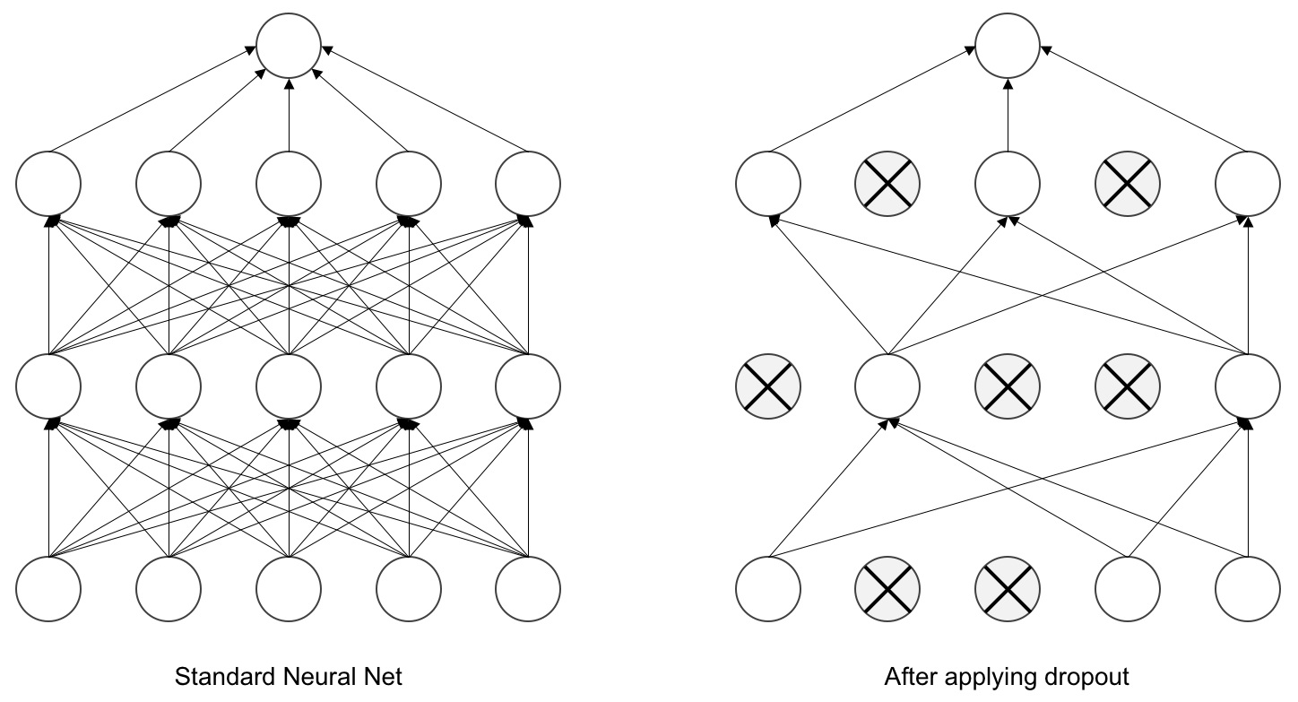
Dropout

Slide 16
Batch normalization
Batch normalization, increase the stability and performance of
neural network training.
It normalizes the output from a layer with zero mean
and a standard deviation of 1.
This reduces overfitting and makes the network train faster.
It is very useful in training complex neural networks.

Slide 17
L1 and L2
L1 penalizes the absolute value of the weight and tends to make the weights
zero.
L2 penalizes the squared value of the weight and tends to make the weight smaller during the train.

Slide 18
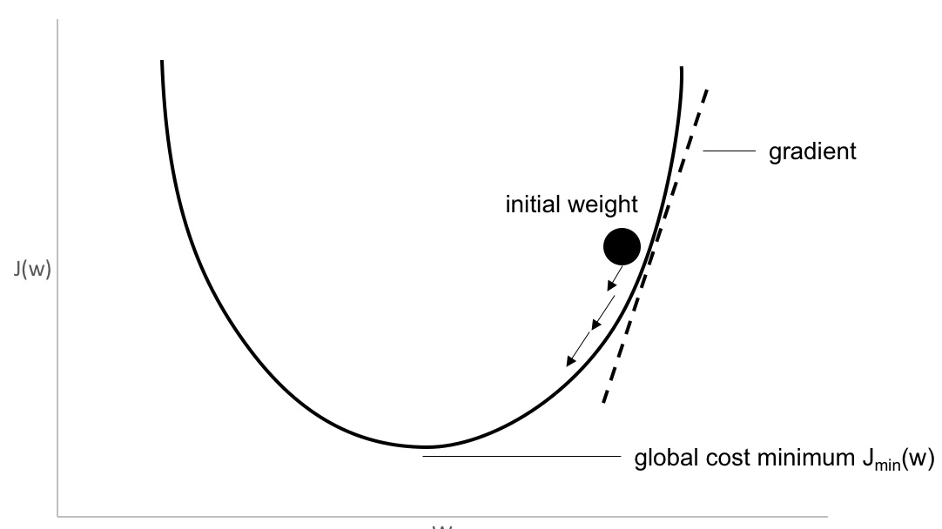
Gradient descent

Slide 19
Gradient descent : visualization
https://yihui.name/animation/example/grad-desc/
http://playground.tensorflow.org/#activation=tanh&batchSize=10&dataset=circle&regDataset=reg-plane&learningRate=0.03&regularizationRate=0&noise=0&networkShape=4,2&seed=0.99346&showTestData=false&discretize=false&percTrainData=50&x=true&y=true&xTimesY=false&xSquared=false&ySquared=false&cosX=false&sinX=false&cosY=false&sinY=false&collectStats=false&problem=classification&initZero=false&hideText=false

Slide 20
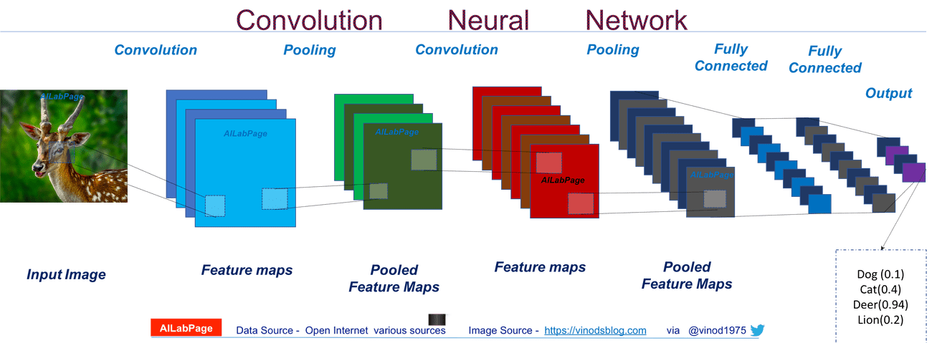
CNN

Slide 21
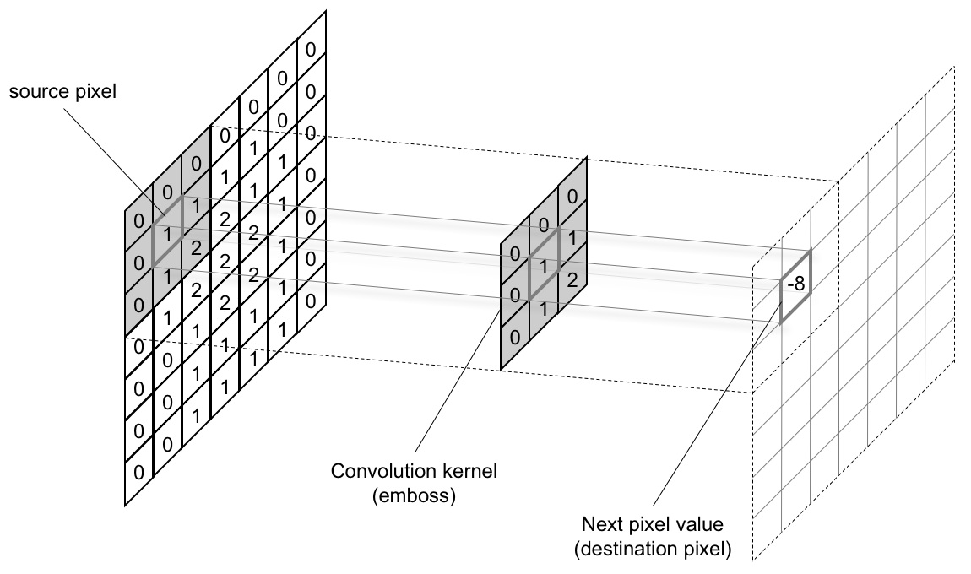
Kernel

Slide 22
Kernel
The kernel has two parameters, called stride and size.
The size can be any dimension of a rectangle .
Stride is the number of pixels moved every time.
A stride of length 1 produces an image of almost the same size, and a stride of length 2 produces half the size.
Padding the image will help in achieving the same size of the input.

Slide 23
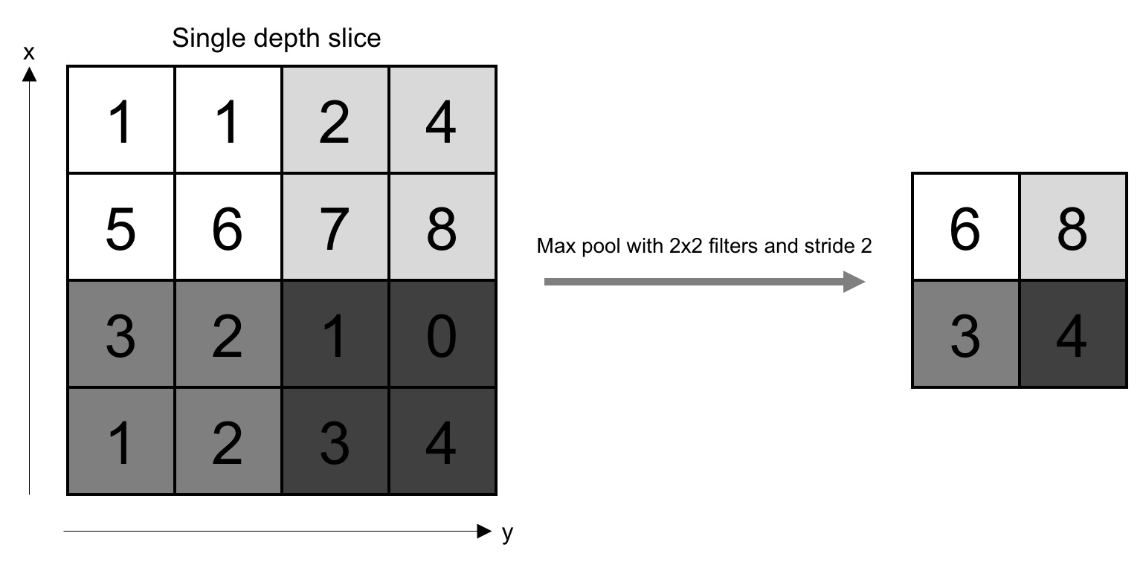
Max pooling

Slide 24
Max pooling
Pooling layers are placed between convolution layers.
Pooling layers reduce the size of the image across layers by sampling.
The sampling is done by selecting the maximum value in a window.
Average pooling averages over the window.
Pooling also acts as a regularization technique to avoid overfitting.
Pooling is carried out on all the channels of features.
Pooling can also be performed with various strides.

Slide 25
CNN visualization
CNN

Slide 26
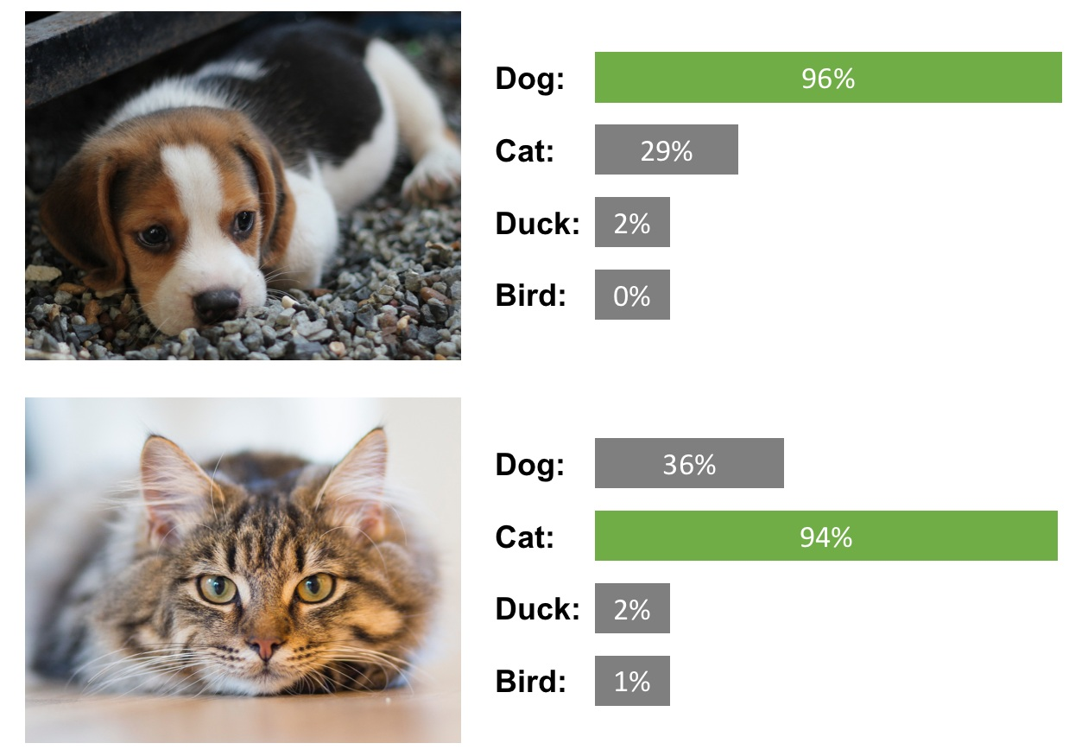
CNN Application

Slide 27
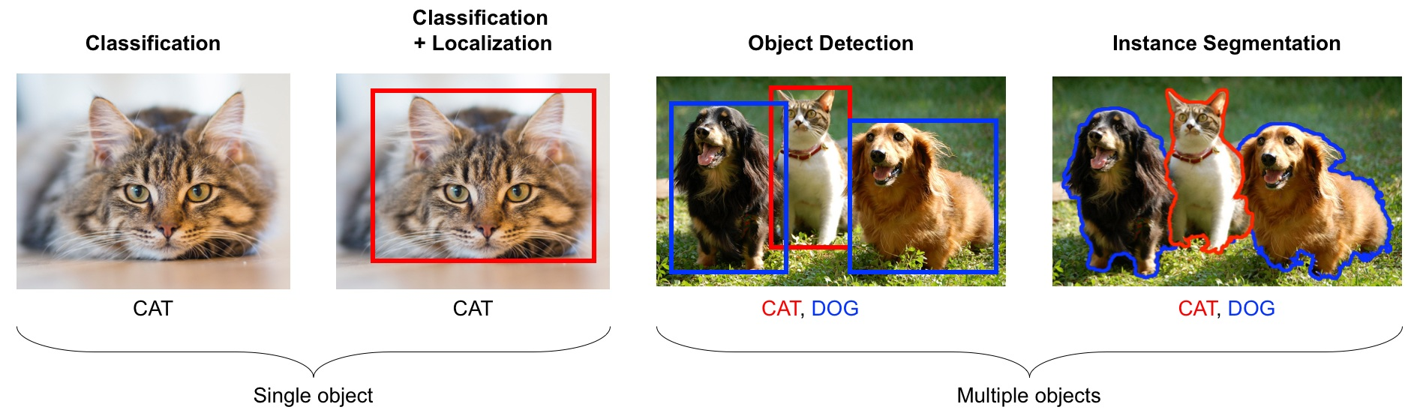
Localization and segmentation

Slide 28
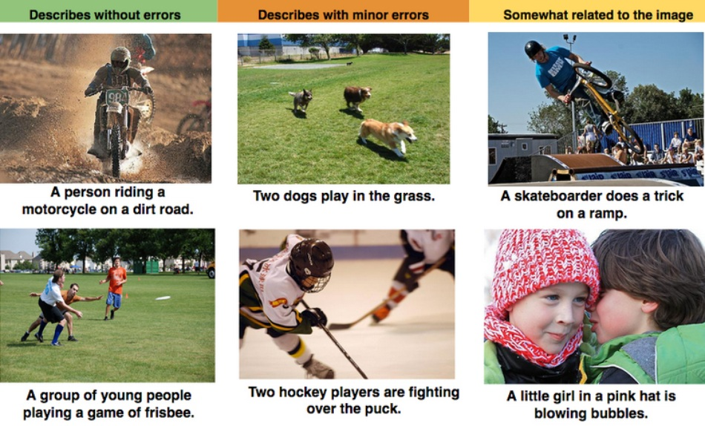
caption

Slide 29
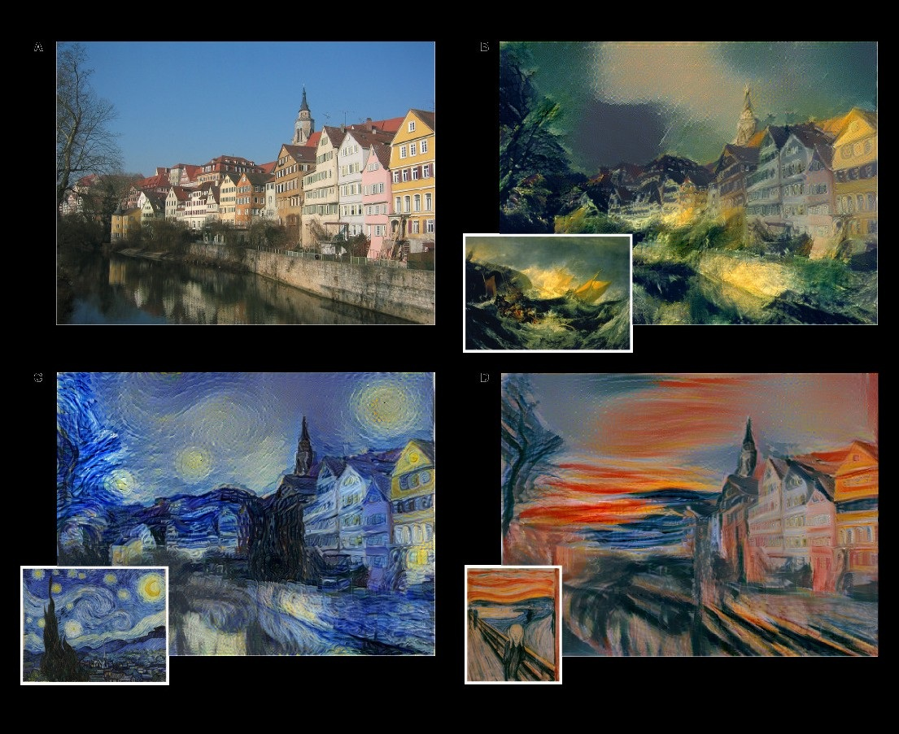
GAN

Slide 30
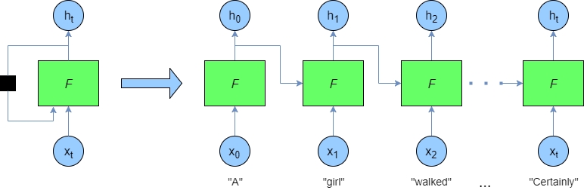
RNN

Slide 31
LSTM
Long short-term memory (LSTM) can store information for longer periods of time, and hence, it is efficient in capturing long-term efficiencies.
LSTM has several gates: forget, input, and output
Forget gate maintains the information previous state.
input gate updates the current state using the input.
output gate decides the information be passed to the next state.
The ability to forget and retain only the important things enables LSTM to remember over a longer time period

Slide 32
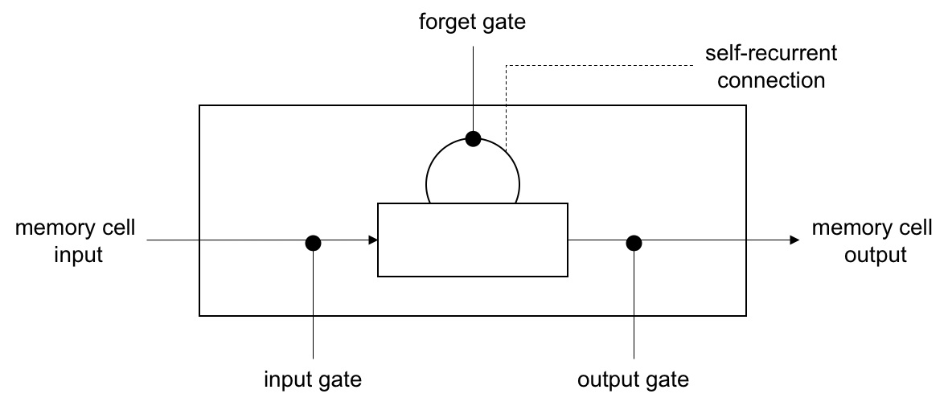
LSTM

Slide 33
Hand-on Session

